Slide 1

THE CARE CHAIR™
Every chair
holds a
market.
Trauma-informed beauty education built to become the recognizable standard for care, consent, and client trust.
Founder: Veronica Robles · Seed Investment Opportunity · Confidential

Slide 2
THE CARE CHAIR™
02
— THE CATEGORY GAP
Beauty services are intimate.
The industry trains for technique,
not the moment a client shuts down.
Stylists, estheticians, makeup artists, and beauty advisors already encounter distress, sensory overwhelm, trauma cues, and consent-sensitive moments. Most have never been given a practical language for what to do next.
01
VISIBLE NEED
02
MISSING TRAINING
03
RECOGNIZABLE SIGNAL
Clients bring real nervous systems into the chair. The service can either create safety or add friction.
Traditional beauty education does not teach trauma-aware communication, pacing, consent, or boundaries.
Clients need an easy way to find professionals who understand care-first service.
Investment Opportunity · Confidential
02

Slide 3

THE CARE CHAIR™
03
— ORIGIN TO PRODUCT
Born in survivor service.
Built for scale.
The Care Chair translates Veronica Robles’ nonprofit work with survivors into a professional curriculum beauty teams can actually use behind the chair.
01
SURVIVOR-INFORMED
The original insight came from real salon services where normal appointment rhythm was not enough.
02
PROFESSIONALLY PACKAGED
A certifiable course, badge, membership, toolkit, and directory make the care standard visible.

Slide 4
THE CARE CHAIR™
04
— PRODUCT SUITE
One certification opens the ecosystem.
The Care Chair is not only a course. It is a credential, a visible salon signal, a continuing membership, and a client-facing discovery layer.
01
02
03
04
CERTIFICATION
CHAIR SIDE™
SALON TOOLKIT
STYLIST DIRECTORY
$99 online curriculum with certificate, TCC badge, and CE pathway.
Monthly practice tools, experts, community, and new modules.
Weighted capes, sensory supports, scripts, signage, and service aids.
Searchable discovery for clients looking for care-first professionals.
Certification → Membership → Toolkit → Directory → Brand / board partnerships
Investment Opportunity · Confidential
04

Slide 5
THE CARE CHAIR™
05
— PROPRIETARY CURRICULUM
Two frameworks.
One standard of care.
The S.A.F.E. Method™ and C.H.A.I.R. Protocol™ give beauty professionals memorable, repeatable language for recognizing distress and responding within scope.
S.A.F.E. METHOD™
C.H.A.I.R. PROTOCOL™
S
SEE
C
CALM
Recognize signs of nervous system activation.
Reduce stimulation and slow the service rhythm.
A
H
HOLD SPACE
ADJUST
Stay grounded, present, and non-reactive.
Modify pace, tone, environment, and positioning.
A
ACKNOWLEDGE
F
FACILITATE
Validate without judgment or over-explaining.
Use grounding and predictability without acting as therapist.
I
INVITE CHOICE
E
Offer options that restore control.
EMPOWER
R
RESTORE
Return control through choice, consent, and pause points.
Pause, ground, adjust, or refer when appropriate.
Investment Opportunity · Confidential
05

Slide 6
THE CARE CHAIR™
06
— CURRICULUM
Six modules.
Practical by design.
~2.5
06
HOURS TOTAL
CORE MODULES
01
TRAUMA AWARENESS
04
SENSORY SUPPORT
How trauma can show up in the salon and where scope begins.
Predictable steps and reduced input for sensitive clients.
02
READING THE CLIENT
05
REGULATION TECHNIQUES
Body language, behavior shifts, and the Pause–Adjust–Proceed approach.
Non-clinical breathing, grounding, and calming practices.
03
COMMUNICATION & CONSENT
06
BOUNDARIES & SAFETY
Permission-based language and ongoing client choice.
Referral language, self-care, and professional limits.
Investment Opportunity · Confidential
06

Slide 7

THE CARE CHAIR™
07
— MARKET OPPORTUNITY
A trusted mark for a large licensed workforce.
1.9M+
575K+
LICENSED COSMETOLOGY PROFESSIONALS IN THE U.S.
ACTIVELY EMPLOYED COSMETOLOGISTS CITED IN SOURCE DECK
$99
At $99 per certification, the first market does not need mass adoption to become meaningful. Membership, toolkit, directory, and retail/brand licensing sit on top of the model.
ENTRY CERTIFICATION PRICE POINT
Investment Opportunity · Confidential
07

Slide 8
THE CARE CHAIR™
08
— REVENUE ARCHITECTURE
Certification creates the first transaction.
Membership compounds it.
Original model examples at $19.50/month Chair Side™ membership.
COURSE
$99
One-time certification revenue
MEMBERSHIP
$19.50/mo
Continuing practice and community
TOOLKIT
TBD
High-intent upsell for certified salons
DIRECTORY
Future
Discovery, premium listings, booking upside
Investment Opportunity · Confidential
08

Slide 9
THE CARE CHAIR™
09
— GO-TO-MARKET
Start where mandate and credibility can move fastest.
The original plan uses Nevada as the launch market, then expands through state boards, luxury beauty relationships, and adjacent service categories.
YEAR 1
YEARS 2–3
YEARS 4–5
Nevada launch
Multi-state + retail
National standard
Introduce curriculum to the Nevada Cosmetology Board; pilot around a focused professional base.
Scale into additional states; present finished product to luxury retail relationships; expand curriculum tracks.
Pursue broader CE adoption, accreditation pathways, international licensing, and category ownership.
Investment Opportunity · Confidential
09

Slide 10
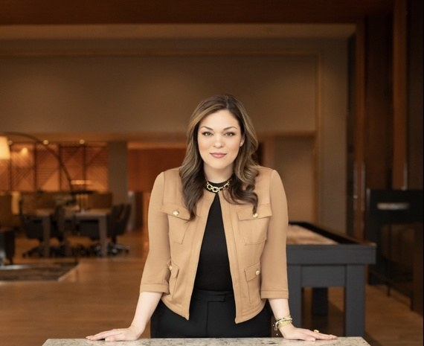
THE CARE CHAIR™
10
— WHY THIS WINS
The moat is not just IP.
It is credibility.
Veronica brings 29 years in beauty, 15 years as a National Makeup Artist for Chanel, nonprofit survivor work, and relationships across both the beauty and civic worlds.
01
FOUNDER-MARKET FIT
02
PROPRIETARY LANGUAGE
Built by someone who has lived the chair, the counter, the luxury floor, and the survivor-service gap.
S.A.F.E. Method™ and C.H.A.I.R. Protocol™ make the behavior teachable and ownable.
03
VISIBLE STANDARD
04
REGULATORY PATH
A certificate, badge, and directory create recognition that clients and salons can understand immediately.
If embedded into CE requirements, the curriculum can move from helpful resource to protected standard.
Investment Opportunity · Confidential
10

Slide 11
THE CARE CHAIR™
11
— USE OF FUNDS
OPERATIONS & WORKING CAPITAL
25% $50K
$200,000
MARKETING & LAUNCH
20% $40K
Seed investment for 20% equity
FILMING & PRODUCTION
15% $30K
Funds the finished curriculum, filming, LMS/site infrastructure, clinical content support, legal/IP, marketing, and launch operations.
TECHNOLOGY & LMS
12% $25K
WEBSITE & HOSTING
10% $20K
CONTENT & CLINICAL DEVELOPMENT
10% $20K
LEGAL & IP PROTECTION
8% $15K
Investment Opportunity · Confidential
11

Slide 12
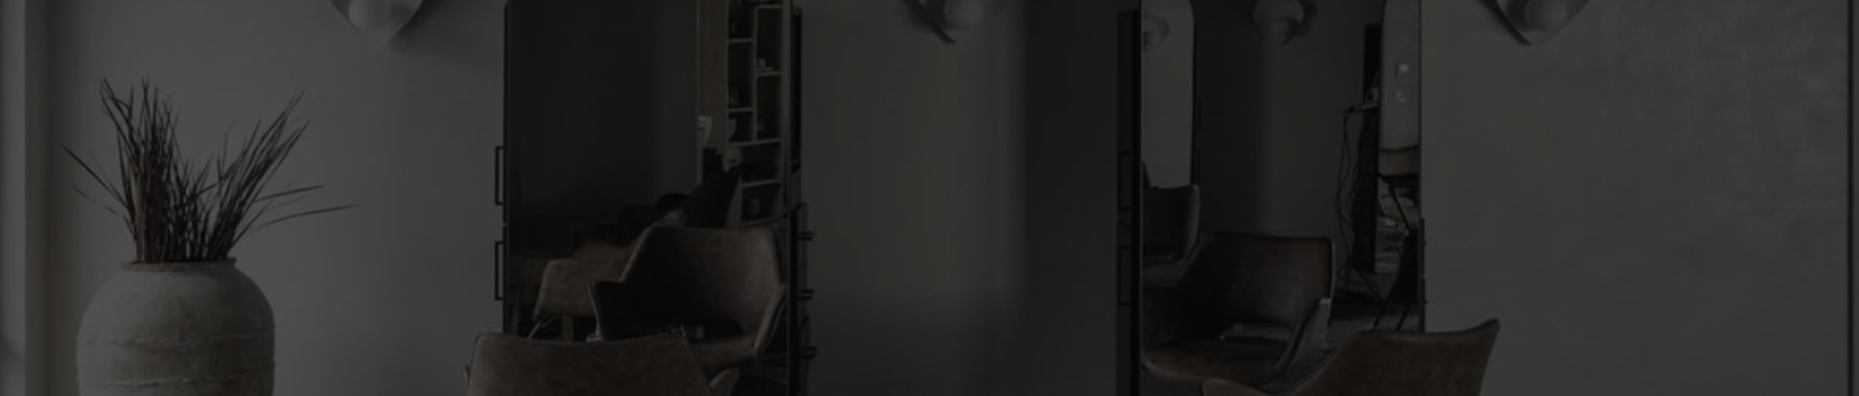
THE CARE CHAIR™
The next standard is care clients can recognize.
The Investment
$200,000 for 20% equity
Join us in building the certification, credential, and visible trust mark for trauma-informed beauty care.
Veronica Robles
Founder & CEO, The Care Chair LLC
Investment Opportunity · Confidential
12

